Slide 1

PROJECT: SMART WEATHER DISPLAY (ISTANBUL) CONNECT WIFI
Zeynep Gizem ÇETİNCİ YALÇIN

Slide 2
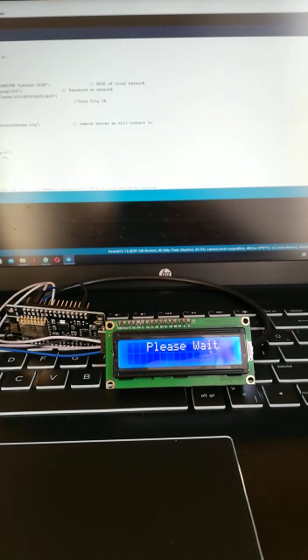
SMART WEATHER DISPLAY (ISTANBUL) CONNECT WIFI

Slide 3
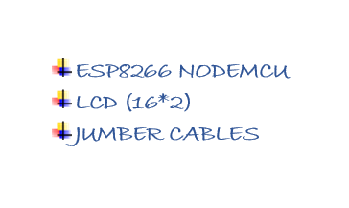
SMART WEATHER DISPLAY (ISTANBUL) CONNECT WIFI

